Slide 1

Preliminary prototype
01

Slide 2
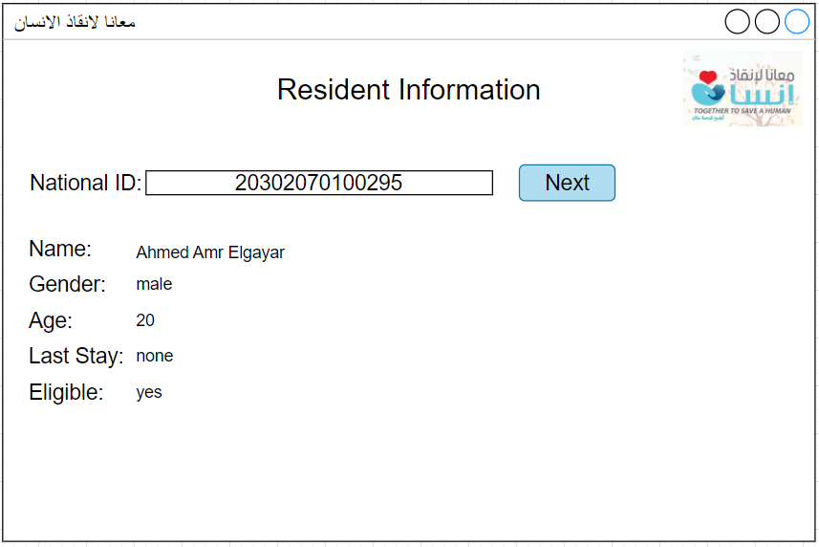
Resident Info.

Slide 3
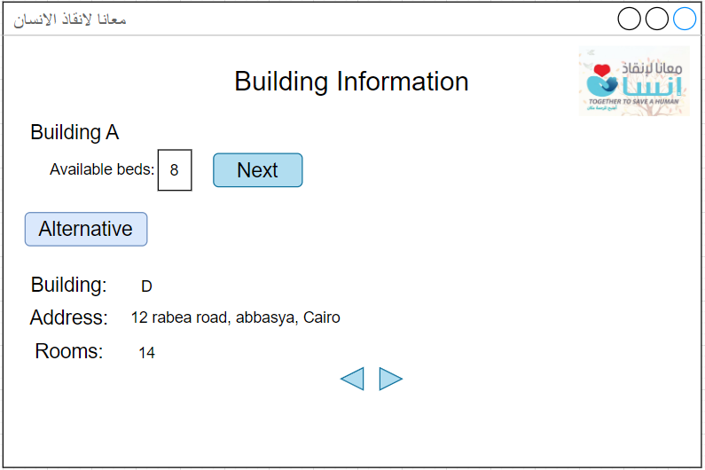
Building selection

Slide 4
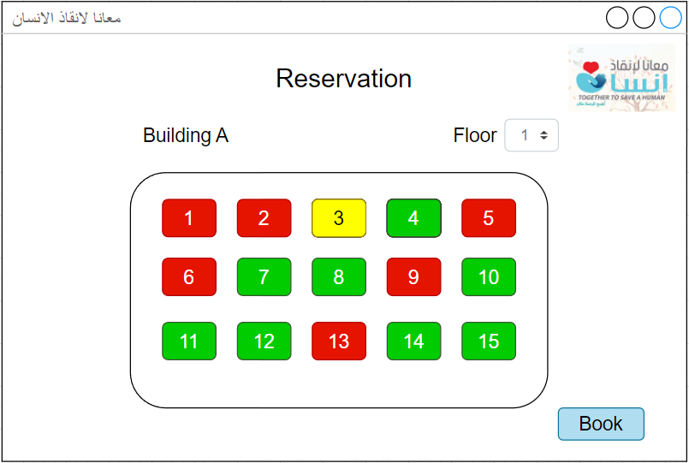
Reservation

